Slide 1
Circuits in Parallel

Slide 2
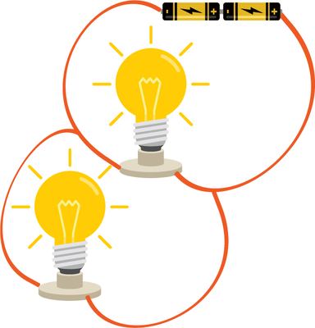
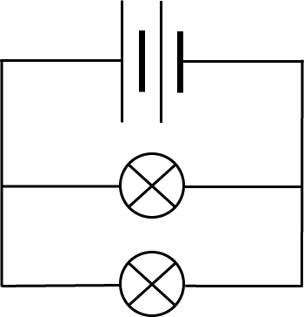
A parallel circuit is made up of many branches or loops of wire.
Each branch has circuit components on it. A parallel circuit is pictured below:

Slide 3
Current is split between branches in parallel circuits.
This is because there are multiple paths which the current can flow down, but each electron can only travel down one path at a time.
This means that the current along each branch is determined by the resistance on the branches. We can add up the value of the current along each branch to find the total current drawn by the battery.

Slide 4
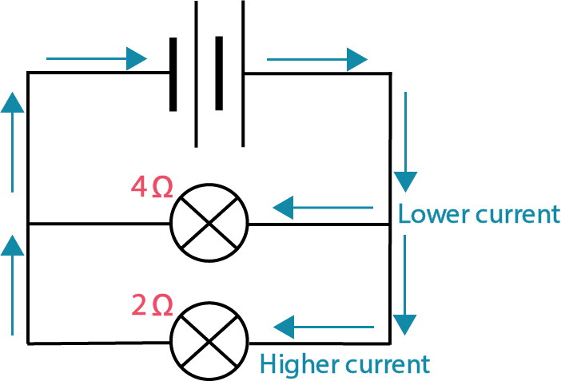
If one branch has a higher resistance than the other, it will have a lower current.
This is because it is more difficult for the electrons to move down the branch with the higher resistance.

Slide 5
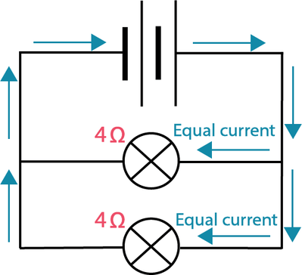
If all branches have the same resistance, there will be the same current along each branch.
This is because it is equally difficult for the electrons to flow down any of the branches.

Slide 6
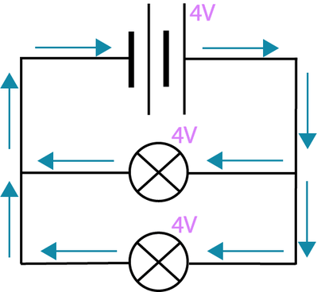
The voltage is the same along every branch in a parallel circuit.
The voltage of a branch is not affected by the resistance of the components. The voltage will be the same even if the resistance values are different.
This means that the two light bulbs in the circuit below have the same voltage across them. For example, if the battery supplies 4 V, each light bulb will have 4 V across them.

Slide 7
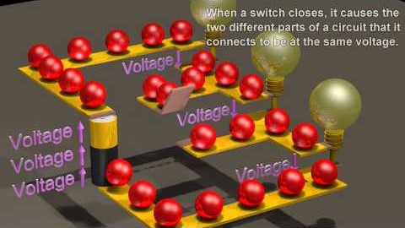
Parallel circuits always have the same rules for current and voltage.
This video (1:27) summarises the information you just learnt about current and voltage in parallel circuits.

Slide 8
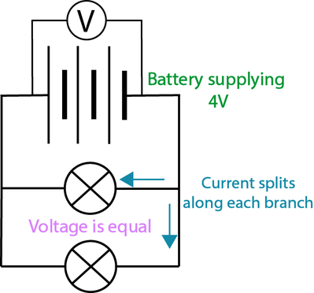
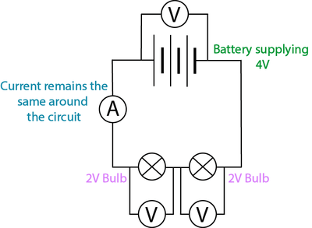
Current and voltage behave differently in series and parallel circuits.
In a series circuit, the current remains the same around the circuit, but the voltage is split between the circuit components.
In a parallel circuit, the voltage remains the same around the circuit, but the current is split between the different branches.

Slide 9
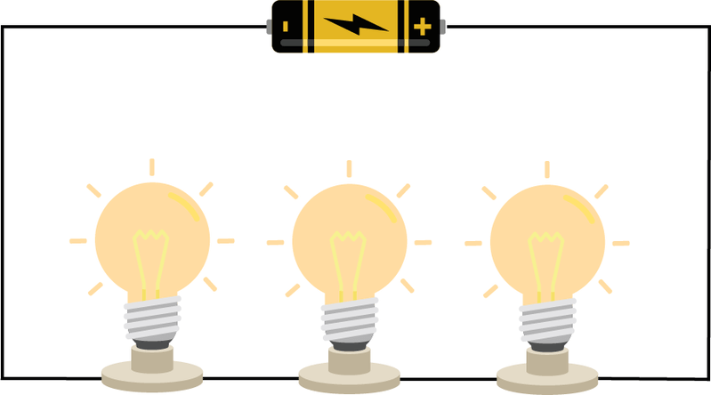
If you connect more light bulbs in a series circuit, they get dimmer.
This is because voltage is split up between components in series circuits.
This means that when more light bulbs are added, each light bulb has less voltage across them. Less voltage results in a dimmer light bulb.

Slide 10
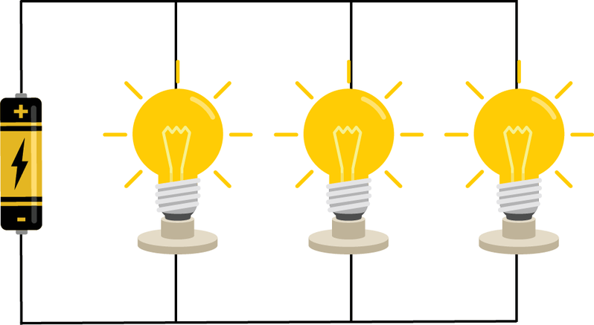
Light bulb brightness does not change in parallel circuits.
This is because voltage is divided equally in parallel circuits, so each light bulb has the same voltage across it when they are added in parallel.

Slide 11
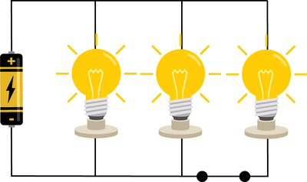
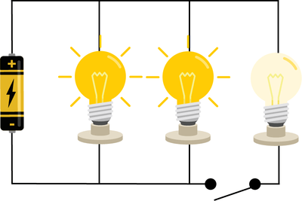
We can use switches to control individual circuit components in parallel circuits.
This is because a switch on a branch will only affect the components on that branch.

